Slide 1

HTML & CSS
C# - MODULE 3, DAY 1

Slide 2

DON’T FORGET
TO RECORD

Slide 3

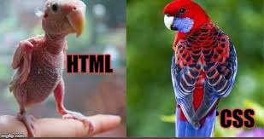
AGENDA
VS Code
HTML
General Tags
Semantic HTML
CSS
HTML form

Slide 4
HTML

Slide 5
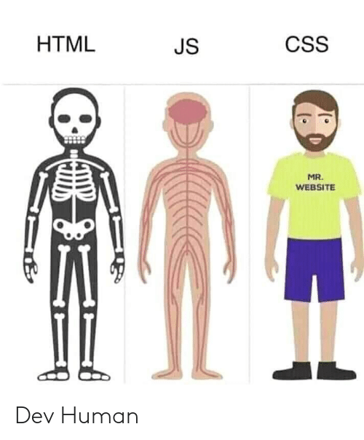
HTML / CSS / JS

Slide 6
HyperText Markup Language
HTML is the standard markup language for Web Pages.
HTML defines the structure of a web page.
HTML defines a document that will be displayed by a web browser (aka rendered).
HTML uses <> tags to represent elements that are the building blocks for a web page.
HTML elements tell the browser how to display the content

Slide 7
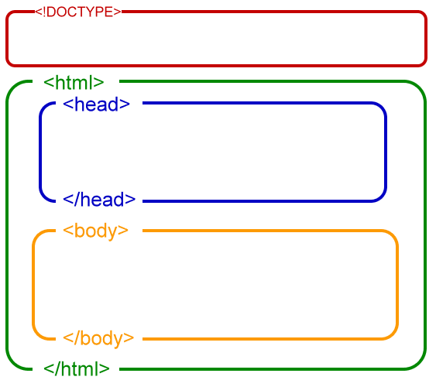
HTML DOCUMENTS
An HTML document must start with the Document Type Declaration.The declaration is not an HTML tag. It is "information" to the browser about what document type to expect.
The HTML document begins with <html> and ends with </html> It is the "root" element. Every other element on the page should be a "descendant" of this element, meaning it's nested underneath, like a folder inside another folder.
The <head> Contains meta information about the document and defines other files you want to include on the page, such as JavaScript or CSS.
The visible part of the document is between the <body> and </body>. There can only be one.
* <head> and <body> are child elements of the <html> element.
Notes:
Review the hierarchical nature of an HTML Document, including parents, descendants, and siblings.

Slide 8
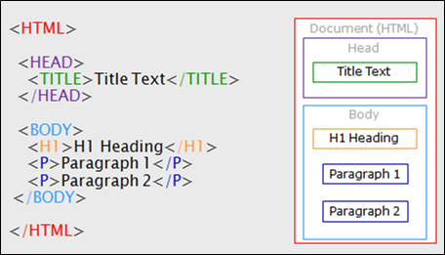
HTML STRUCTURE
Notes:
Review the hierarchical nature of an HTML Document, including parents, descendants, and siblings.

Slide 9
HTML: Tags
HTML tags define elements on a page.
HTML tags are identified by <> and have both a opening and closing tag
<div></div>
Some tags don't have any content between them. If that's the case, you don't need a closing tag. It is self closing, meaning they can be opened and closed in the same tag.
<img src=”myimage.jpg” />

Slide 10
Tags go next level with attributes
An attribute is piece of code that's included between the angle brackets.
<img src=”images/john_matrix.png”>
Attributes are often used to "extend" a tag by changing its behavior or providing metadata.
<a>Visit W3Schools</a>
<a href="https://www.w3schools.com">Visit W3Schools</a>

Slide 11
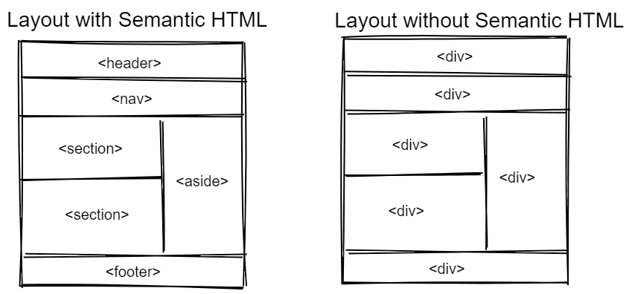
Without Semantic HTML
<!DOCTYPE>
<html>
<head>
<stuff>
</head>
<div>
<stuff>
</div>
<div>
<stuff>
</div>
<div>
<stuff>
</div>
<div>
<stuff>
</div>
<div>
<stuff>
</div>
<div>
<stuff>
</div>
</html>

Slide 12
Semantic HTML
<!DOCTYPE>
<html>
<head>
<stuff>
</head>
<header>
<stuff>
</header>
<nav>
<stuff>
</nav>
<aside>
<stuff>
</aside>
<section>
<stuff>
</section>
<section>
<stuff>
</section>
<footer>
<stuff>
</footer>
</html>
Semantic elements clearly describe its meaning to both the browser and the developer. They define the purpose of the content and how it relates to the structure of the page. Examples: <header>, <main>, <section>, <article>

Slide 13
Importance of Semantic HTML
Screen Readers, used by the visually impaired, use semantic elements to help users navigate
Search engines treat content in tags differently depending on the semantics
Makes code easier to maintain and read
Suggests to the developer what type of data that element should contain
HTML should be coded to represent the data, and not based on its default presentation styling. Presentation (meaning how it should look) is the sole responsibility of CSS.
Semantic HTML ( W3Schools )
Semantic HTML ( Mozilla Developer Docs )

Slide 14
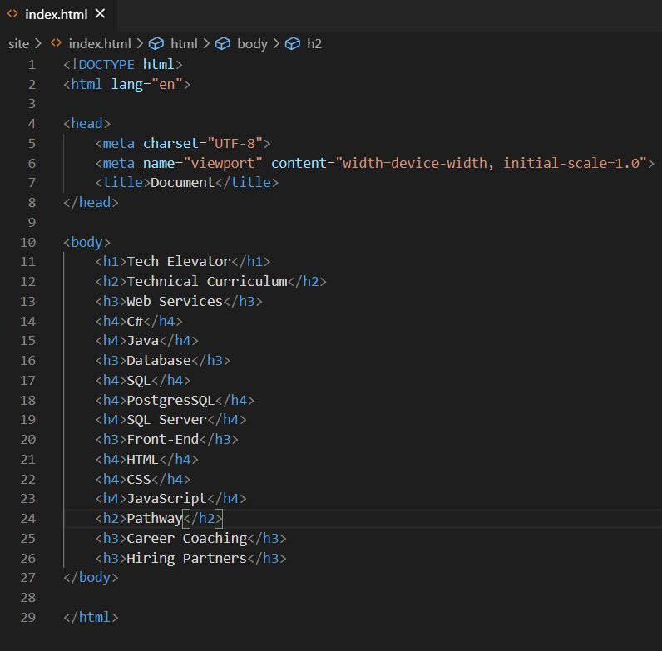
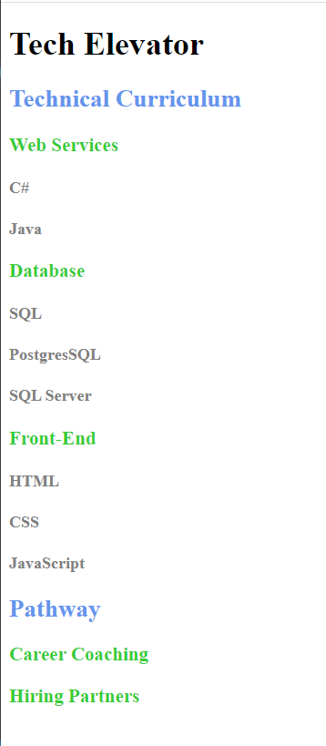
Use heading tags in descending order

Slide 15
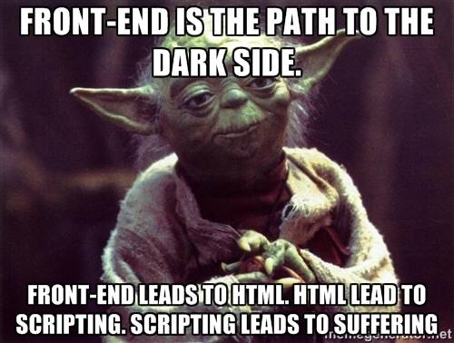
BREAK
DON’T FORGET TO PAUSE/UNPAUSE RECORDING

Slide 16
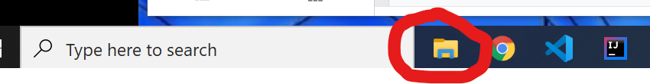
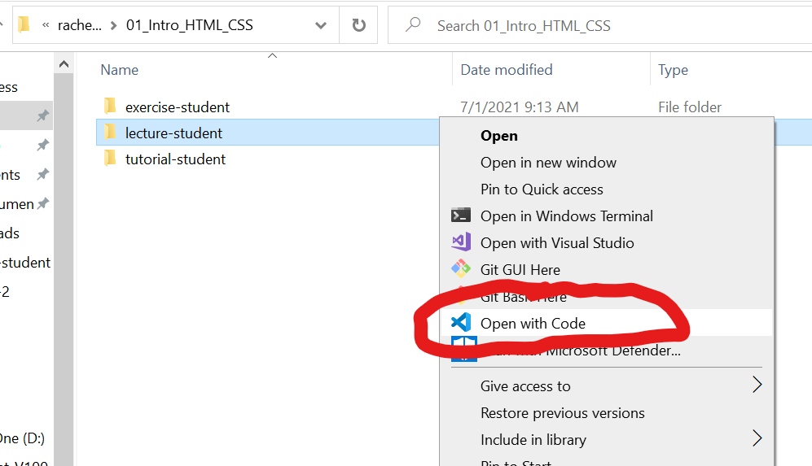
Let’s head to the code
Go to file explorer
Navigate to the lecture-student
Right click lecture-student folder
Select Open with Visual Studio Code

Slide 17
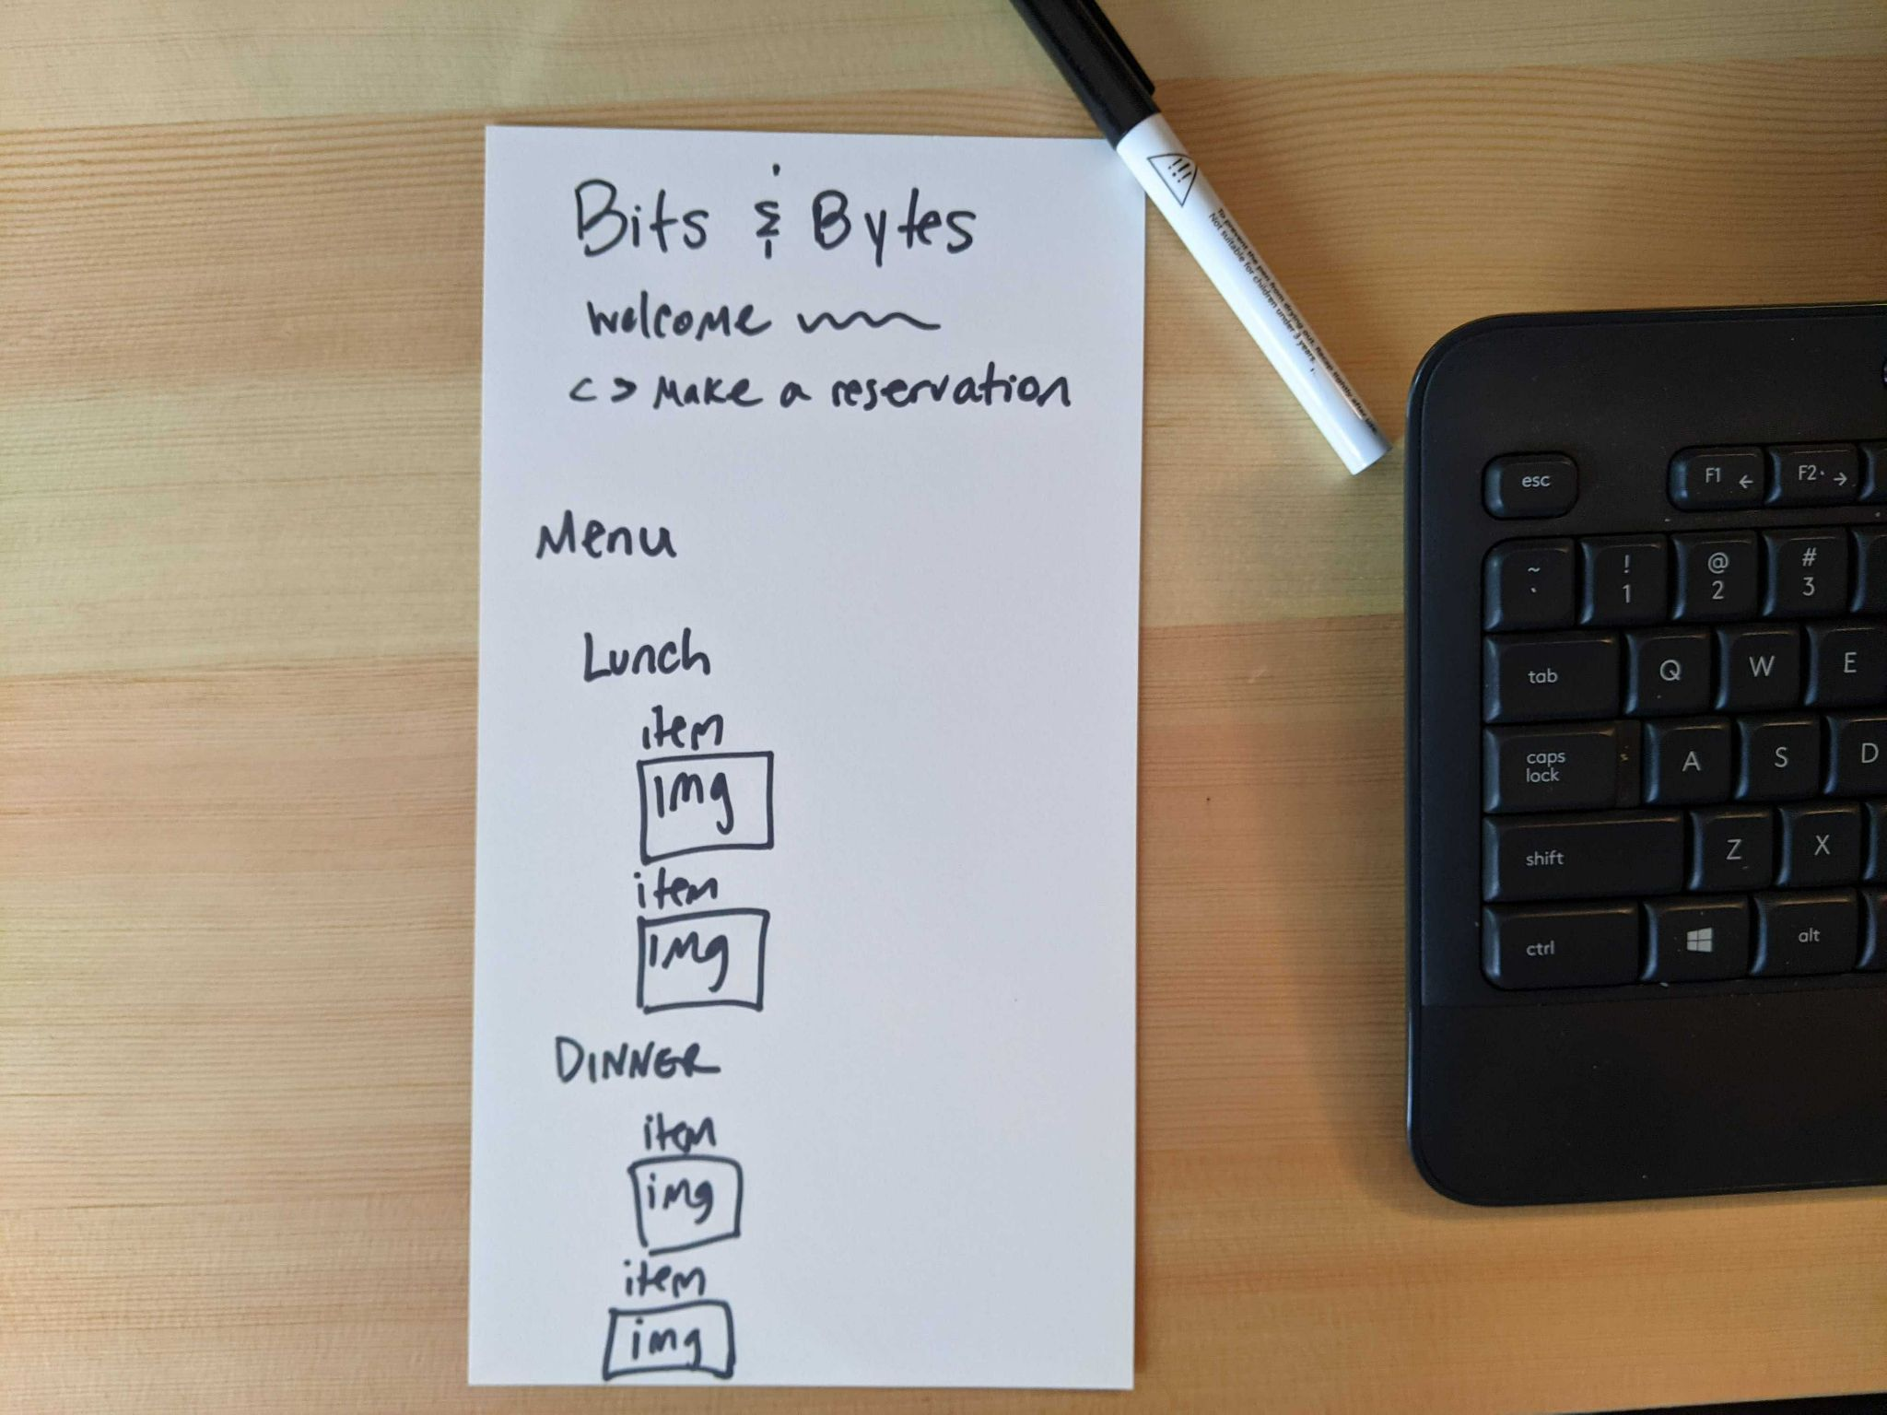
Layout

Slide 18
CSS

Slide 19
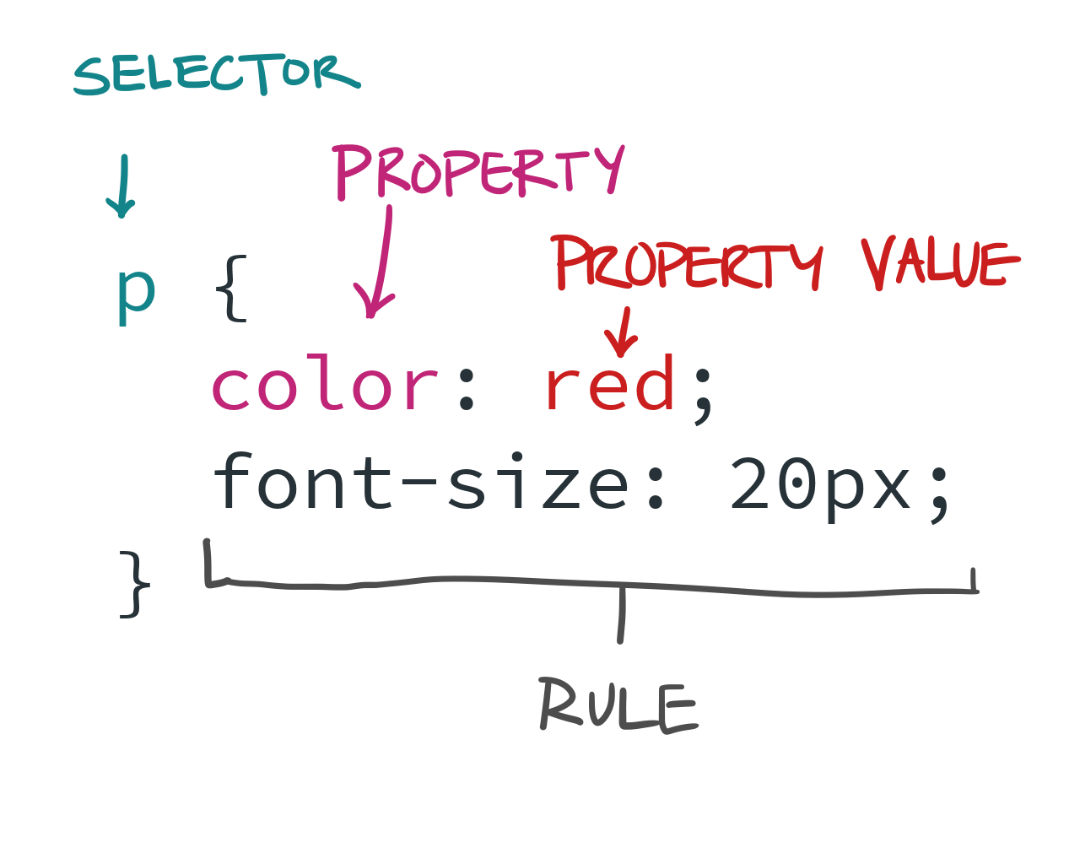
CSS
CSS (Cascading Style Sheet)
CSS defines presentation for an HTML document.

Slide 20
CSS LOCATION
inline on any element with a style attribute
within the document under a <style> element
through an external document reference with a <link href=> element
Adding a CSS file to an HTML file.
For a file named styles.css:
<link rel=”stylesheet” href=”styles.css” />

Slide 21
ELEMENT SELECTOR
CSS
HTML
Output
p {
color: red;
font-size: 36px;
}
<p>Hello</p>
Hello

Slide 22
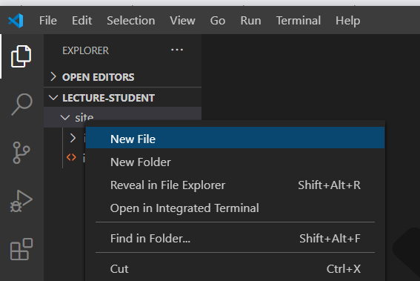
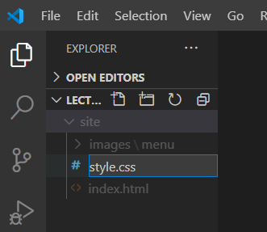
Let’s head back to the code
In the VS Code file explorer pane, right click in the site folder and select "New File."
2. You'll be prompted to enter a name for the file: Name the new file: styles.css

Slide 23
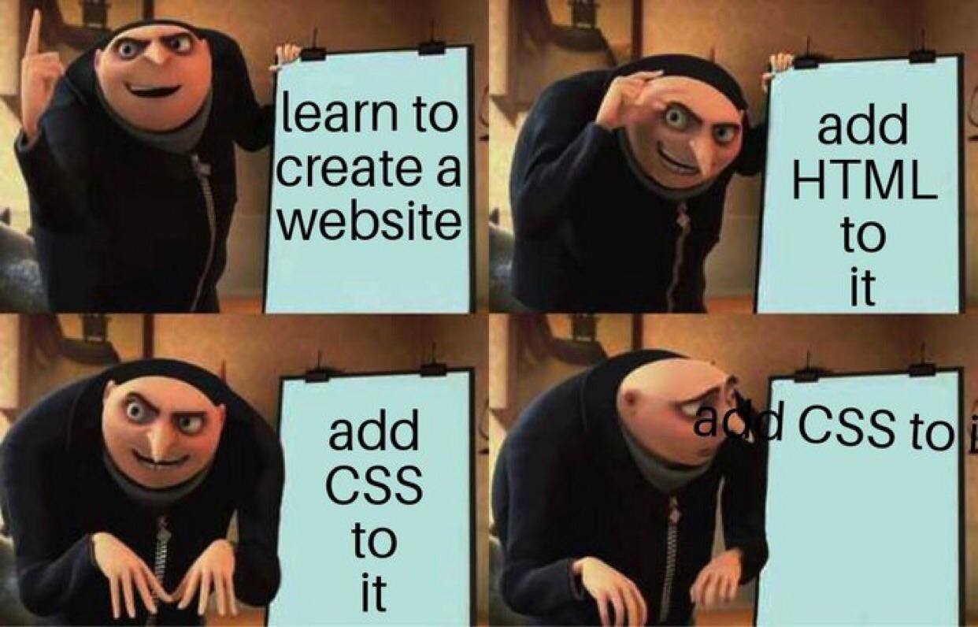
BREAK
DON’T FORGET TO PAUSE/UNPAUSE RECORDING

Slide 24
FORMS

Slide 25
HTML Forms
Forms are a way for the client to submit data to the server.
The form tag has 2 required attributes:
action=”url”
method=”http_method” (Defaults to GET)
<form action=”/reservations” method=”POST”>
If the action points to an endpoint URL on the same server where the HTML originated then it can be relative, otherwise it will be absolute.
<form action=”/reservations” method=”POST”> ← relative <form action=”http://localhost:8080/reservations” method=”POST”> ← absolute

Slide 26
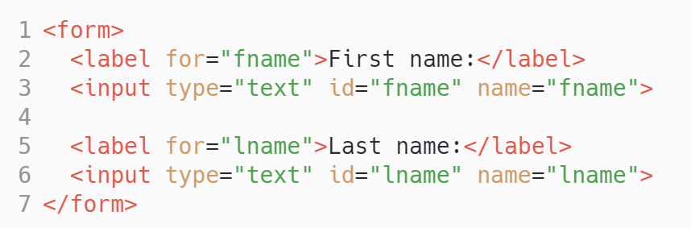
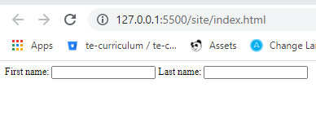
FORMS
The form tag has 2 required elements:
action=”url”
method=”http_method”
(GET or POST)
<form action=”/reservations” method=”POST”>
name - This is the name of the value that gets sent to the server, sent via the query string, or in the request body
type - sets the type of user interaction (radio button, text field, checkbox, etc)
id - name unique to the page that is used to internally identify the input field by CSS and JavaScript
Notes:
Form elements are HTML tags that allow users to input data to be sent in the request to the server.

Slide 27
FORMS
Make sure the “for” attribute on the label element matches the “id” on the corresponding input tag.
The form tag has 2 required elements:
action=”url”
method=”http_method”
(GET or POST)
<form action=”/reservations” method=”POST”>
name - This is the name of the value that gets sent to the server, sent via the query string, or in the request body
No, seriously!! Only form elements with a name attribute will have their values passed when submitting a form.
type - sets the type of user interaction (radio button, text field, checkbox, etc)
id - name unique to the page that is used to internally identify the input field by CSS and JavaScript
Notes:
Form elements are HTML tags that allow users to input data to be sent in the request to the server.

Slide 28
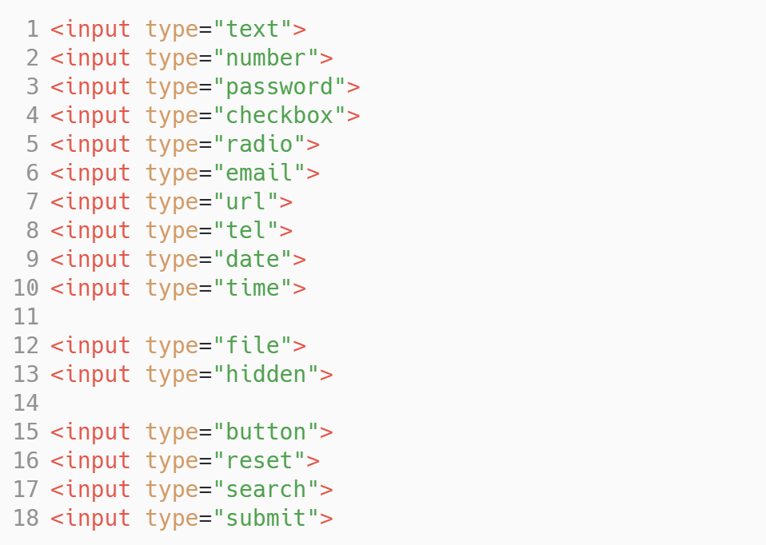
INPUTS

Slide 29
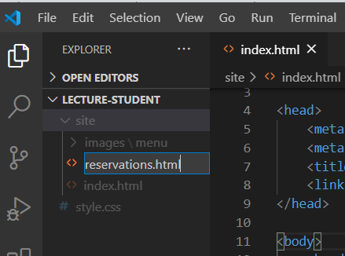
Let’s head back to the code
In the VS Code file explorer pane, right click in the site folder and select "New File."
2. You'll be prompted to enter a name for the file: Name the new file: reservations.html

Slide 30
BOOK & CHEAT SHEET
https://v2-3-techelevator-book.netlify.app/content/intro-html-css.html https://stuffandnonsense.co.uk/archives/css_specificity_wars.html
https://htmlcheatsheet.com/
https://htmlcheatsheet.com/css/

Slide 31
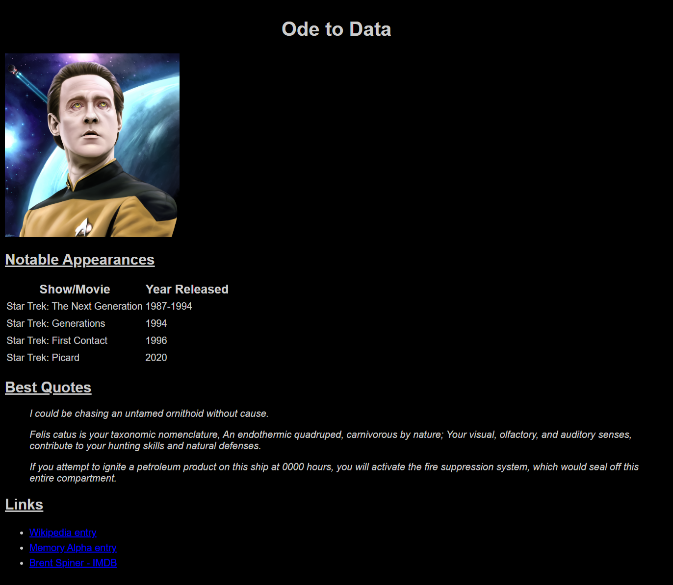
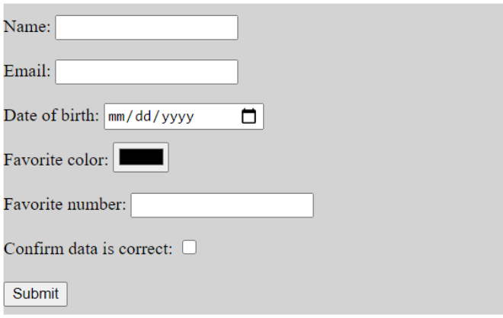
STUDENT EXERCISE
Notes:
https://bitbucket.org/te-curriculum/te-curriculum-v1/src/master/module-4/01_Intro_HTML_CSS/student-exercise/

Slide 32

HAPPY CODING!

